Slide 1

So, you are thinking of studying Geography for A Level at St. Louis?
Good Choice…….
but then again we are biased!

Slide 2

AS/A2 Level
Geography at
St. Louis
We would rather
you knew
Why
it would be a good choice

Slide 3

Why study Geography?

Slide 4
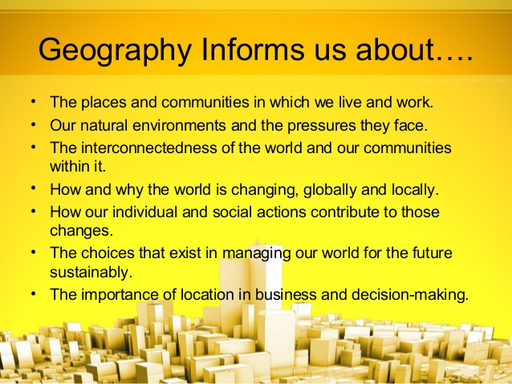
What does Geography do for me?

Slide 5
‘So many of the world’s current issues – at a global scale and locally – boil down to geography, and need the geographers of the future to help us understand them. Global warming as it affects countries and regions, food and energy security, the degradation of land and soils from over-use and misuse, the spread of disease, the causes and consequences of migration, and the impacts of economic change on places and communities.’ Michael Palin
The world is constantly changing
….and Geographers lead the change!

Slide 6
The Specification-
What will I Study?
CCEA
AS Geography40%
A2 Geography 60%
AS 1 Physical Geography
Rivers
Ecosystems
Weather and Climate
A2 1 Physical Geography
Plate Tectonics (Theory & Outcomes)
Tropical Ecosystems (Nature and Sustainability)
AS2 Human Geography
Population
Settlement
Development
AS 2 Human Geography
Planning for Sustainable Settlements
Tourism
AS 3
Fieldwork Investigation
A2 3
Decision Making Exercise

Slide 7
Assessment
Year 13
AS 2
AS 1
AS3
Year 14
A2 1
A2 2
A2 3
For Units AS 1 & AS 2 you will sit an examination lasting 1 hour and15 minutes esch. AS 3 (1 Hour)
For A21, A2 2& A2 3 you will sit and examination lasting 1 hour and 30 minutes each
Questions will be multi-part and will be range from source response questions to case study questions.

Slide 8
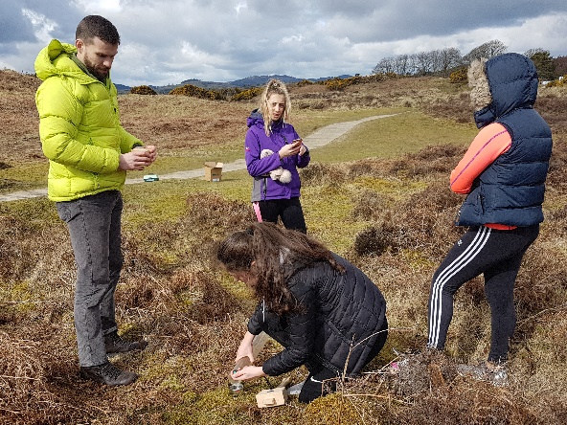
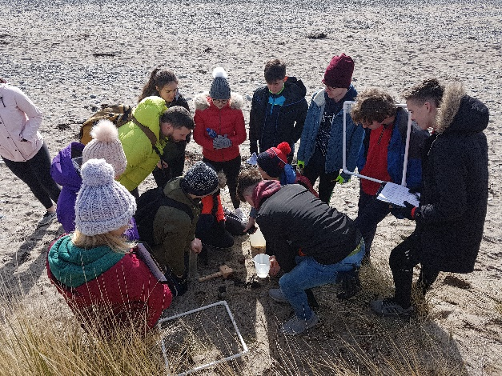
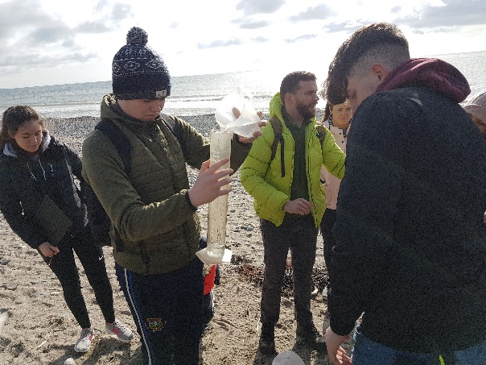

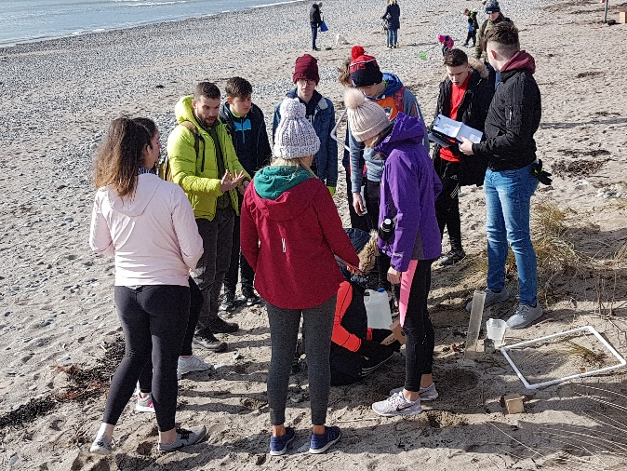
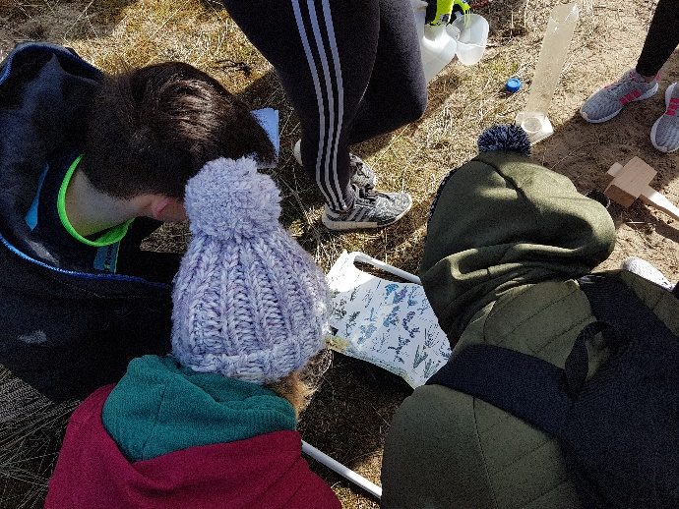

Murlough Nature Reserve AS Geography

Slide 9
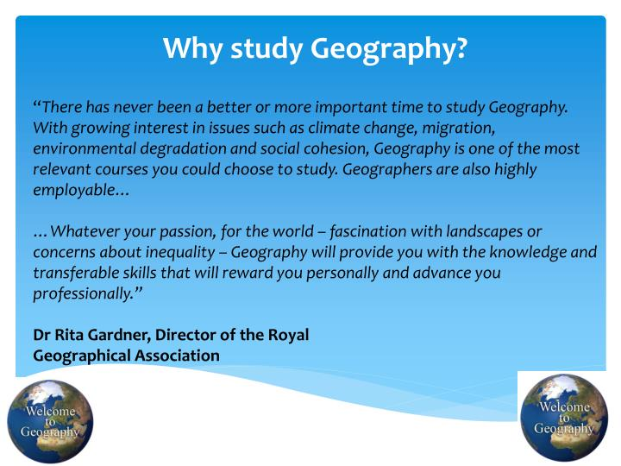
So, again you ask the question?

Slide 10
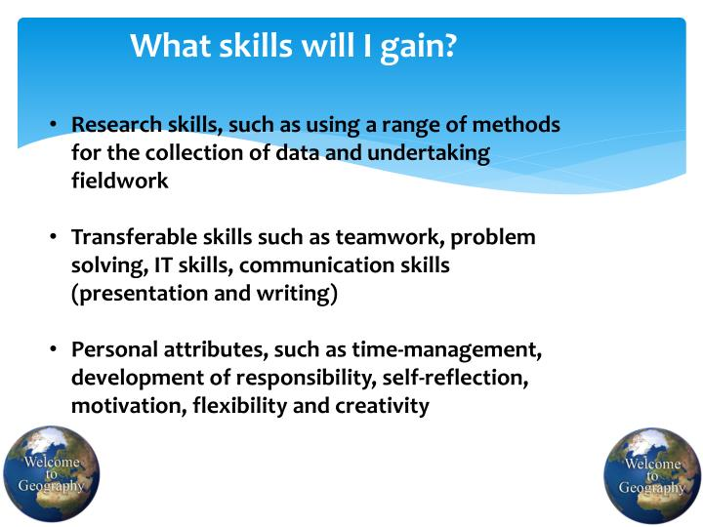
And we remind you of the skills gained..
And we remind you of the skills gained…

Slide 11
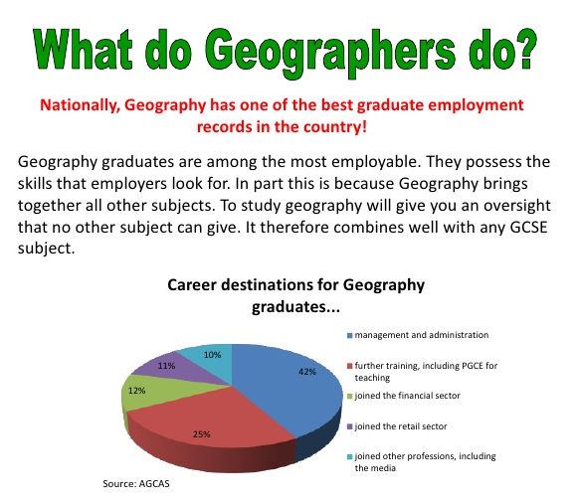

So what can I do ?
-Careers with Geography

Slide 12


Slide 13
Additional Information on A Level Geography!
Geography Right Here, Right Now!
https://youtu.be/dDk06h7Abbw
Why Study Geography?
https://youtu.be/t_a5OLScri0
Visit you Examines website
Geography Student Guide.pdf (ccea.org.uk)

